Slide 1

School-Based Interventions for Children and Youth with ADHD
Gregory A. Fabiano, Ph.D.
Florida International University
gfabiano@fiu.edu
http://ccf.fiu.edu/wny
Acknowledgements: The work described in this manuscript was supported by funding from the NIMH (5F31MH064243, 1R34MH078051), NICHD (R01HD058588, R01HD105318), Department of Education Institute of Education Sciences (R324J06024, R324B060045, R305A150230, R324A160133, R305A170523, R324A180175, R324A19039) the Centers for Disease Control and Prevention (1U01CE001653), Administration for Children and Families (90PD0278)

Slide 2
Conflict of Interest Statement
Research funding has been received from: ACF, CDC, NIMH, NICHD, IES, Shire, Adlon
Royalties received from Guilford Press
Consulting agreement with FastBridge Learning

Slide 3
Acknowledgements
Michael Adragna, Children’s Hospital
Ariel Aloe, University of Iowa
Amy Altszuler, Florida International University
Lisa Burrows-MacLean, University at Buffalo
Anil Chacko, New York University
Sandy Chafouleas, University of Connecticut
Andrea Chronis-Tuscano, University of Maryland
Erika Coles, Florida International University
Charles Cunningham, McMaster University
Steven Evans, Ohio University
Elizabeth Gnagy, Florida International University
Andrew Greiner, Florida International University
Chanelle Gordon, Boy’s Town
Kat Hart, Florida International University
Tim Hayes, Florida International University
Larry Hawk, University at Buffalo
Karen Hulme, Roswell Park, Buffalo
Kevin Hulme, University at Buffalo
Kellina Lupas, Cincinnati Children’s Hospital
Michael Manos, Cleveland Clinic Children’s Hospital
Greta Massetti, CDC
Chelsey McCabe, Children’s Hospital Buffalo
Faith Miller, University of Minnesota
Brittany Merrill, Florida International Univ.
William E. Pelham, Jr. , Florida International University
Linda Reddy, Rutgers University
T. Chris Riley-Tillman, University of Missouri
Nicole Schatz, Florida International University
Devon Tower, Florida International Univ.
Rob Volpe, Northeastern University
Rebecca Vujnovic, University at Buffalo
Dan Waschbusch, Penn State Hershey
Jim Waxmonsky Penn State Hershey
Michael Willoughby, RTI International
Matthew Valente, Univ. of South Florida
Jihnhee Yu, University at Buffalo
Many other students, colleagues, community collaborators, and families, teachers, children

Slide 4
Attention-deficit hyperactivity disorder (ADHD)
ADHD is characterized by developmentally inappropriate levels of:
  Inattention
  Hyperactivity
  Impulsivity
ADHD behaviors are developmentally inappropriate, pervasive, chronic, and result in considerable impairment in social and academic functioning.

Slide 5
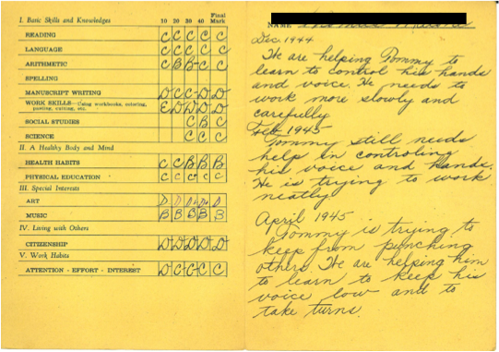
First Grade
“Helping to learn to control his hands and voice”
“Needs to work more slowly and carefully”
“He is trying to work neatly”
“Trying to keep from punching others”
“Helping him to keep his voice low and to take turns”

Slide 6
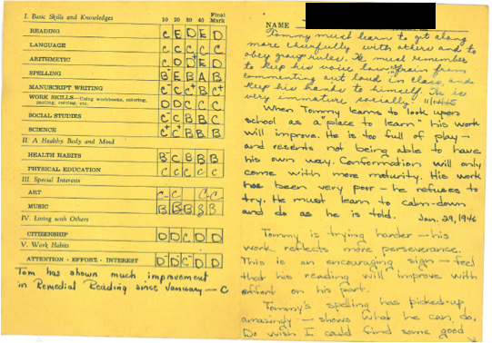
Second Grade
“Must learn to get along more cheerfully with others and obey group rules”
“Must refrain from commenting out loud in class and keep his hands to himself”
“He must learn to calm down and do as he is told”
“Do wish I could find some good outlet for his boundless energy”

Slide 7
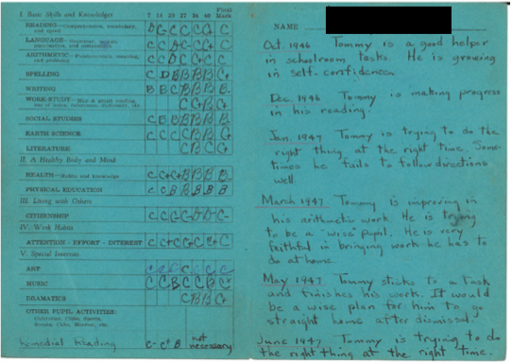
Third Grade
“Is trying to do the right thing at the right time”
“Sometimes he fails to follow directions well”
“It would be a wise plan for him to go straight home after dismissal”

Slide 8
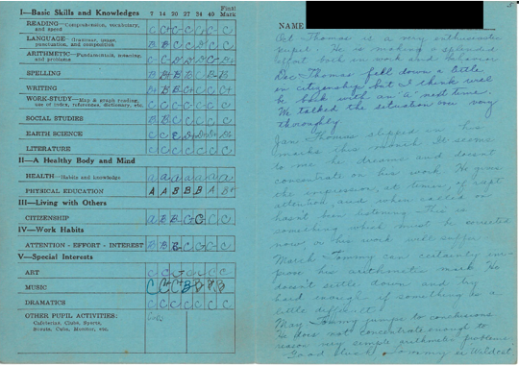
Fourth Grade
“It seems to me he dreams and does not concentrate on his work”
“He gives the impression of rapt attention and when called on hasn’t been listening”
“He doesn’t settle down and try hard enough if something is a little difficult”
“He does not concentrate enough to reason very simple arithmetic problems”

Slide 9
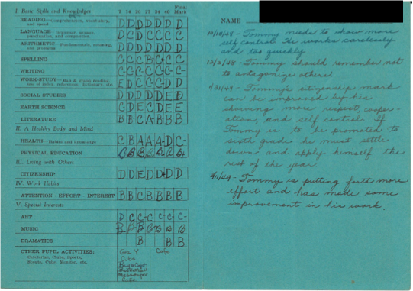
Fifth Grade
“Needs to show more self-control”
“He works carelessly and too quickly”
“Should remember not to antagonize others”
“He must settle down and apply himself the rest of the year”

Slide 10
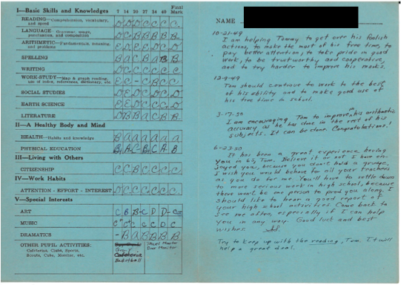
Sixth Grade
“I am helping him to get over his foolish actions, to make the most of his free time, to
pay better attention, to take pride in good work, to be trustworthy and cooperative
and to try harder to improve his marks.”

Slide 11
History of ADHD
Heinrich Hoffman, a German psychiatrist, authored a widely-published children’s book of short stories in 1844.
  “Fidgety Phillip”
  “Johnny Look-in-the-Air”
    “The Story of Cruel Frederick”
    The Story of Little Suck a Thumb”
    The Dreadful Story of Pauline and the Matches”
Thome & Jacobs, 2004

Slide 12
Prevalence

Slide 13
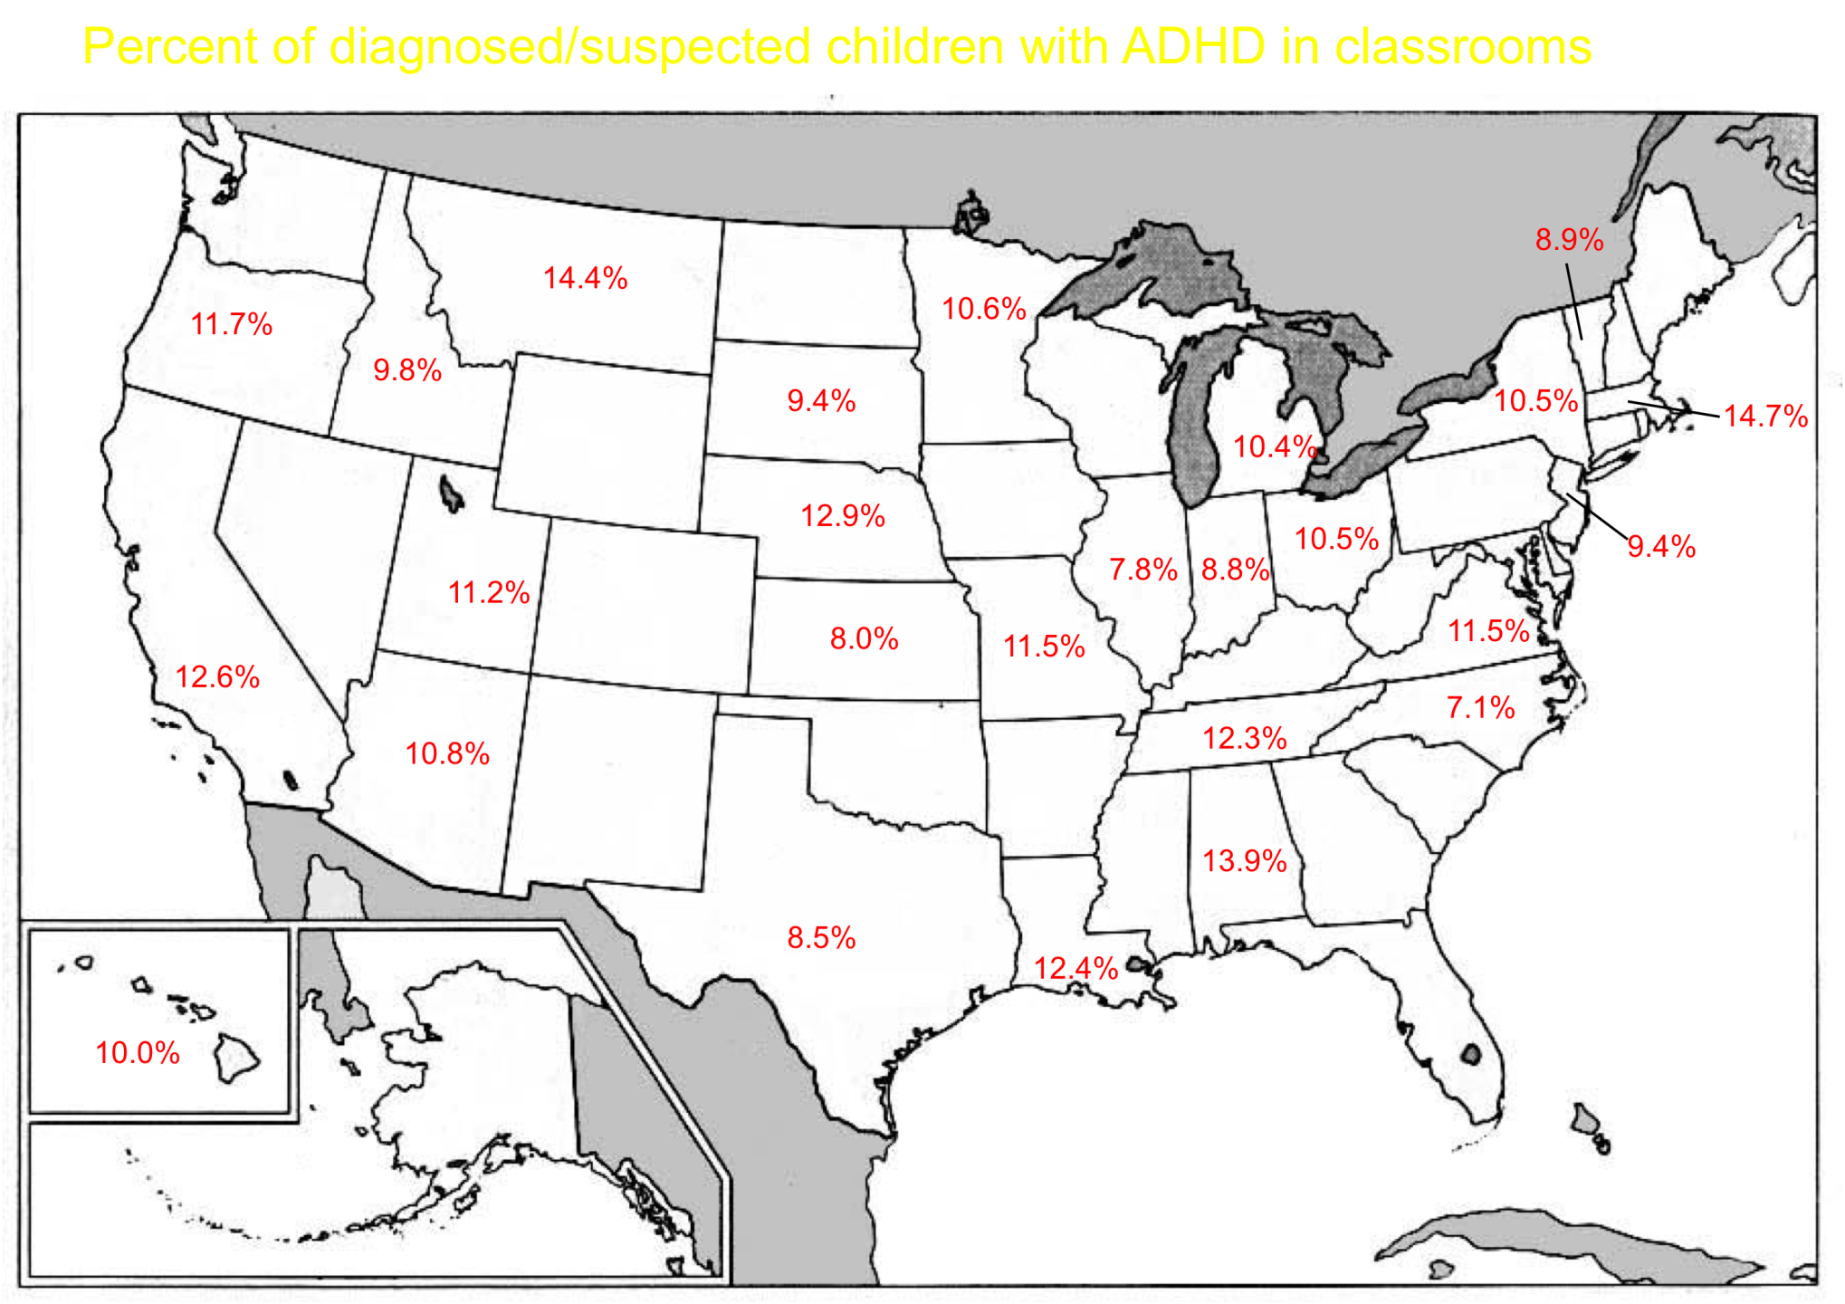
Fabiano et al., 2014

Slide 14
Impact of ADHD - Costs

Slide 15
Educational Costs
(Robb et al, under review)
Costs of
Special education* $3230
Disciplinary referrals** $ 740
Retention $ 110
Special schools $ 780
Total: $4900
*Does not include Section 504 Accommodation Plans/OHI classifications not used
pre-1992
**Likely under-estimated

Slide 16
Costs in the Aggregate
(assuming prevalence of 5% and 60 million school aged children--2000 census--2005 dollars)
Health and Mental Health $11.6 billion
Education $14.7 billion
Crime and Delinquency $11.4 billion
Parental work loss $ 2.3 billion
Total $40 billion
Range $34.1--$53.7
Pelham, Foster, & Robb, 2007; Robb et al., 2011

Slide 17
Annual Cost of Other Disorders in U.S.
Depression: $44 billion
Stroke: $53.6 billion
ADHD (child, $80 billion
adolescent, adult)
Alzheimer’s $100 billion
Alcohol abuse/dep $180
Drug abuse/dep $180

Slide 18
Impact of ADHD on the Child/Teen/Adult

Slide 19
Academic Functioning
33% of ADHD have academic problems (special ed., academic probation, dropped out, or held back) every year, vs. 2% of controls
48% of ADHD children have at least one year of special education placement vs. 3% of controls
12% of ADHD vs. 5% of controls have been held back a grade
9% of ADHD adolescents drop out of school vs. 1% of controls
ADHD adolescents a full letter grade lower than controls, with twice the rate of absences

Slide 20
Average Discipline Problems By Grade

Slide 21
Academic Outcomes
For young adults (18 and over):
  21% of ADHD vs. 10% of controls complete vocational training in high school
  44% of ADHD vs. 92% of controls have ever been on academic honor roll
  52% of ADHD vs. 83% of controls have received education post high-school

Slide 22
Academic Achievement
ADHD sample has significantly lower standardized WRAT scores than controls:
Reading: 99 (12) vs 108 (10)
Spelling: 94 (16) vs 107 (10)
Math: 92 (14) vs 106 (16)

Slide 23
ADHD Young Adults (18 and older) Have Lower Academic Attainment
 | ADHD | Control
Partial High School | 13% | 2%
H.S. or G.E.D. | 37% | 20%
Partial community college or vocational training | 22% | 7%
Partial college | 20% | 59%
2 year degree or vocational training | 1% | 1%
4 year degree or greater | 4% | 11%

Slide 24
Evidence-Based Assessments for ADHD

Slide 25
DSM-5 Definition for Attention-Deficit/Hyperactivity Disorder
A. Six Symptoms of either Inattentive or Hyperactive/Impulsive
(1) Inattention:
often fails to give close attention to details or makes careless mistakes in schoolwork, work, or other activities
often has difficulty sustaining attention in tasks or play activities
often does not seem to listen to what is being said to him or her
often does not follow through on instructions and fails to finish schoolwork, chores, or duties in the workplace
often has difficulties organizing tasks and activities
often avoids or has difficulties engaging in tasks that require standard mental effort
often loses things necessary for tasks or activities
is often easily distracted by extraneous stimuli
often forgetful in daily activities
APA, 2022

Slide 26
DSM-5 Definition for Attention-Deficit/Hyperactivity Disorder
  (2) Hyperactivity-Impulsivity:
    often has difficulty playing or engaging in leisure activities quietly
    is always "on the go" or acts as if "driven by a motor”
    often talks excessively
    often blurts out answers to questions before the questions have been completed
    often has difficulty waiting in lines or awaiting turn in games or group situations
    often interrupts or intrudes on others (e.g. butts into other's conversations or games)
    often runs about or climbs inappropriately
    often fidgets with hands or feet or squirms in seat
    leaves seat in classroom or in other situations in which remaining seated is expected
APA, 2022

Slide 27
DSM-5 Definition for Attention-Deficit/Hyperactivity Disorder-Subtypes
Predominantly Inattentive Presentation: Criterion (1) is met but not criterion (2) for the past six months
Predominantly Hyperactive-Impulsive Presentation: Criterion (2) is met but no criterion (1) for the past six months
Combined Presentation: Both criteria (1) and (2) are met for the past six months
APA, 2022

Slide 28
What is NOT Evidence-based
Medical Tests
Allergy Tests
CAT/PET scans, MRI scans
Asking the child about symptoms

Slide 29
Evidence-based Assessment of ADHD symptoms
There are a number of well-developed, validated, and useful measures for identifying the presence of ADHD symptoms.
Many of these are in the form of parent and teacher rating scales.
Pelham, Fabiano, & Massetti, 2005

Slide 30
Assessments Beyond Diagnosis
Diagnosis is only one aspect of assessments for ADHD.
With the assessment technology available, diagnosing ADHD has become relatively efficient and it is backed by a strong psychometric evidence base.

Slide 31
Once a diagnosis is established, the focus should shift to the rest of the assessment process including:
  Identifying impaired areas of functioning
  Operationalizing target behaviors within these domains
  Conducting a functional analysis of the antecedents, settings, and targets of the target behavior(s)
  Implementing treatment and constructing measures to monitor and evaluate treatment progress
Pelham, Fabiano, & Massetti, 2005

Slide 32
Summary and Recommendations
There is considerable psychometric information available to support ADHD assessments.
Diagnostic procedures for ADHD can be conducted relatively easily using evidence-based methods.
  Parent and Teacher Rating Scales
  Clinical interview to determine onset of symptoms and rule out other potential diagnoses.
  Structured diagnostic interviews for ADHD do not add incremental validity for assessments.

Slide 33
Clinicians and consumers should be mindful of incremental validity.
Assessments should emphasize an accounting of key domains of functioning, focusing on areas of competency and impairment.
Assessments should emphasize a careful analysis of the context of impaired behaviors
  Antecedents
  Consequences
  Settings
Focus of assessment activities is weighted toward those that facilitate treatment planning.

Slide 34
A comment on school supports
The long-term educational outcomes for individuals with ADHD, on a group level, are shockingly poor.
Current, formal school approaches (IEPs, 504 Accommodation Plans) have done little to meaningfully improve outcomes
Multi-tiered systems of support, with intervention provided more quickly, and in the general education classroom, should be the focus.

Slide 35
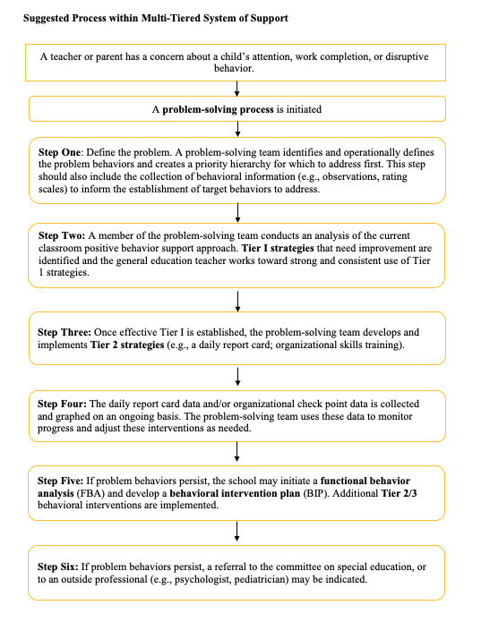
Multi-Tiered Systems of Support
Fabiano et al., in preparation

Slide 36
Effective Interventions for ADHD

Slide 37
Evidence-Based ADHD Treatments
Behavior Modification
  Classroom Contingency Management
  Behavioral Parent Training
  Peer Interventions in Recreational Settings
Stimulant Medication
Combination of Behavior Modification and Stimulant Medication
DuPaul & Eckert, 1997; Fabiano, et al., 2009; Greenhill & Ford, 2002; Hinshaw et al., 2002; Pelham & Fabiano, 2008; Pelham, Wheeler, & Chronis, 1998

Slide 38
Evidence-Based Short-term Treatments for ADHD
(1) Positive Behavior Supports
-48 classroom studies (N > 900)
-80 parent training studies (N > 5,000)
(including prior to DX cat./ODD/CD)
(2) CNS stimulant medication
>250 studies (N > 5000)
(3) The combination of (1) and (2).
>25 studies (N > 800)
Most studies are crossover studies

Slide 39
Positive Behavior Supports

Slide 40
ADHD Treatment Effect Sizes

Slide 41
Teacher resigns after duct-taping student
Wednesday, March 3, 2004 Posted: 6:12 PM EST (2312 GMT)
ORAN, Missouri (AP) -- A teacher resigned last month after duct-taping a misbehaving seventh-grader to his desk and covering his mouth with tape, the school superintendent said Wednesday.

Slide 42
School-based interventions

Slide 43
Classroom interventions
1. Classroom rules and structure
    •Be respectful of others
    •Obey adults
    •Work quietly
    •Stay in assigned seat/area
    •Use materials appropriately
    •Raise hand to speak or ask for help
    •Stay on task/complete assignments
2. Ignore mild inappropriate behaviors that are not reinforced by peer attention and praise appropriate behaviors
3. Private reprimands (at child's desk as much as possible) and appropriate commands (clear, brief, specific)

Slide 44
4. Rules and structure for individual child (e.g., desk placement, task sheet)
5. Premack contingencies (e.g., recess time contingent upon completing work)
6. Daily report card/notebook
7. Response cost/reward point or token system for the target child.

Slide 45
8. Classwide interventions (e.g., class lottery)/group contingencies (e.g., "good behavior game", child earning a reward for the entire class); response cost/reward point or token system for the entire class.
9. Time out (classroom, office, systematic exclusion).
10. Special class placement and special services (Federal IDEA and 504 guidelines for ADHD; see 1997 reauthorization).
11. School-wide Programs.

Slide 46
Tier 1 Universal Behavioral Supports

Slide 47
Use sparingly
Logical consequences
Ignore, distract, redirect
Clear limits, class rules, consistent follow-through
Use liberally
Praise & encouragement
Rewards & celebrations
Empathy, attention, listening, encouragement, good teaching

Slide 48
And yet. . .
Approximately 2:1 Ratio
Approximately 4:1 Ratio
Reddy, Fabiano et al., 2013

Slide 49

Attention and Praise
“Catch children being good.”
Comment on appropriate behavior.
Balanced attending between classmates.

Slide 50

Effective Requests
Bad Requests
Issued when it is unclear whether the child is attending
Contain multiple steps
Vague
Issued as a question
Unclear phrasing (Let’s . . .)
Extended for a long period of time
Repeated without consequences

Slide 51
Good Requests
Issued once attention is obtained
Issued in manageable steps
Specific
Issued as a command/instruction
Use clear phrasing
Limited to the present
Followed by consequences for both compliance (e.g., praise) and noncompliance (e.g., repeat command).

Slide 52

Planned Ignoring
Deliberately ignore minor, inappropriate behaviors.
  Especially if the behaviors are attention-seeking!
Attend to and return to appropriate behavior

Slide 53

Premack Contingencies and Transitional Warnings
“Grandma’s Rule”
Help children know about and prepare for transitions/changes in routine.

Slide 54
Class-wide Programs for Tier 1 Behavior

Slide 55
Class-wide Programs for Tier 1 Behavior
Currently there are many models of class-wide behavioral interventions to target disruptive behavior. For example:
The Good Behavior Game
Class-wide Point System
Class-wide Lottery
Class-wide Time out Program

Slide 56
The Good Behavior Game
Teachers target specific behaviors.
The class is divided into two (or more) teams.
Each time a target behavior is exhibited, the team receives a checkmark on the board.
Teams that do not exceed the maximum number of checkmarks are rewarded each day.
Barrish, Saunders, & Montrose, 1969; Joslyn et al., 2019

Slide 57
The Good Behavior Game: Results
Students from classrooms that used the Good Behavior Game were compared to those that did not.
At the end of first grade, intervention students were:
Less shy and less aggressive when rated by teachers
Had fewer peer ratings of aggressive behavior
The most aggressive boys exhibited less aggression when followed-up in 6th grade.

Slide 58
(Christ & Christ, 2006)
Group Contingency with High School Students
High school teachers targeted disruptive and off-task behavior during instruction
2-minute timer was set to countdown at the beginning of class
If the timer reached zero prior to a negative behavior, the class earned a point
If a negative behavior was exhibited, the timer was reset
The class had to earn 17 points to earn free time at the end of class.

Slide 59
Results
Christ & Christ, 2006

Slide 60
Daily Report Cards in Schools
Tier 2
Gregory A. Fabiano, Ph.D.
University at Buffalo, SUNY

Slide 61

Conflict of Interest Statement
Volpe & Fabiano, 2013

Slide 62
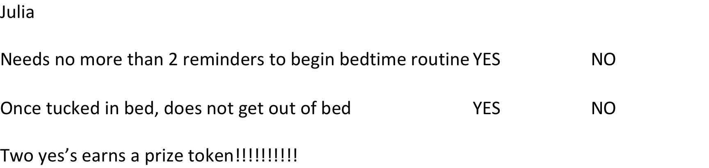
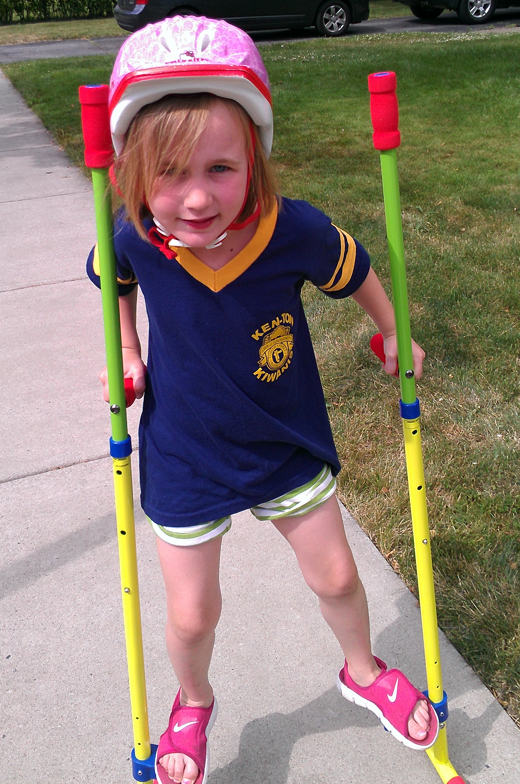

Slide 64
Daily Report Card

Slide 65
What is a Daily Report Card (DRC)?
The DRC is an operationalized list of a child’s target behaviors
  Specific criteria
  Immediate feedback
  Communication tool
  Home-based privileges contingent on meeting DRC goals

Slide 66
Why Use a DRC?
The DRC is an evidence-based intervention for ADHD in schools (DuPaul & Eckert, 1997; DuPaul & Stoner, 2004; Evans & Youngstrom, 2006; Fabiano & Volpe, 2013; Pelham & Fabiano, 2008; Pelham, Wheeler, & Chronis, 1998; U.S. Department of Education, 2004)
Time & cost effective for teachers
Students receive immediate feedback
  Explicit feedback from the teacher may also serve as an antecedent to future appropriate behavior (Sugai & Colvin, 1997)

Slide 67
Why Use a DRC?
Provides daily communication
  Important for an intervention to facilitate communication (Pisecco, et al, 1999)
  May contribute to amenable parent-teacher relationships (Dussault, 1996).
  May enhance relationships between teacher, parent and child (e.g., Pianta, 1996)
Allow for continued progress monitoring & monitoring outcomes (e.g., Chafouleas, Riley-Tillman, & McDougal, 2002; Cheney, Flower, & Templeton, 2008; DuPaul & Stoner, 2003; Evans et al., 1995; Pelham, Fabiano, & Massetti, 2005; Riley-Tillman, Chafouleas, & Breisch, 2007)

Slide 68
Evidence for DRC Efficacy
Single Subject Studies | Design | N | Methodological Rigor | Results/Effect sizes
Atkins, Pelham, & White (1989) | ABCDAEF | 1 | Does not Meet WWC Evidentiary Standards | Most effective when combined with other interventions (school rewards, seat change, response cost)
Fabiano, & Pelham (2003) | Multiple Baseline | 1 | Does not Meet WWC Evidentiary Standards | Child demonstrated improved behavior when the DRC was implemented
Jurbergs, Palcic, & Kelley (2007) | ABAB | 6 | Meets WWC Evidentiary Standards with Reservations (At least one phase for all cases has only four datapoints) | DRCs with and without response cost improved student behavior
Kelley, & McCain (1995) | ABAB | 5 | 1/5 Cases meet WWC Evidentary Standards | Majority of students behaved best with response cost component in DRC
McCain, & Kelley (1993) | ABAB | 1 | Meets WWC Evidentiary Standards with Reservations (Reversal phase has only four datapoints) | Improved behavior demonstrated with the DRC
McCain, & Kelley (1994) | Multiple Baseline | 3 | Meets WWC Evidentiary Standards with Reservations (One baseline phase has only four datapoints) | School home notes with response cost component were most effective
Miller, & Kelley (1994) | ABAB and Multiple Baseline | 4 | Does not Meet WWC Evidentiary Standards for ABAB design; Meets WWC Evidentiary Standards with reservations for multiple baseline designs | 2/4 subjects evinced clear reversal once DRC removed
Pelham, & Fabiano (2001) | AB | 1 | Does not Meet WWC Evidentiary Standards | Child demonstrated improved behavior when contingent rewards implemented

Slide 69
Between Group Studies | Design | N | Methodological Rigor | Results/Effect sizes
Fabiano, et al. (2010) | Between Group | 63 | Meets WWC Evidentiary Standards | Children in special education who had a DRC based on IEP goals/objectives exhibited better behavior and received improved teacher ratings of academic productivity relative to a business as usual control
Jurbergs, Palcic, & Kelley (2010); Palcic, Jurbergs, & Kelley (2009) | Between Group | 43 | Meets WWC Evidentiary Standards | Children who received classroom or home-based rewards for DRCs exhibited more on-task behavior and completed more seatwork correctly than a control group; Parent consequences more effective than no parent consequences
Murray, Rabiner, Schulte, & Newitt (2008) | Between Group | 24 | Does not Meet WWC Evidentiary Standards (Non-equivalence of groups at baseline) | Children who received the DRC rated as improved on teacher ratings
O'Leary, Pelham, Rosenbaum, & Price (1976) | Between Group | 17 | Meets WWC Evidentiary Standards | Children who received the DRC rated as improved on classroom observations
Note: Many studies of children with ADHD included the DRC as part of a multi-component intervention. For the purposes of this table, only stand-alone
studies are included.

Slide 70
Identifying Impaired Areas of Functioning/Operationalizing Target Behaviors

Slide 71
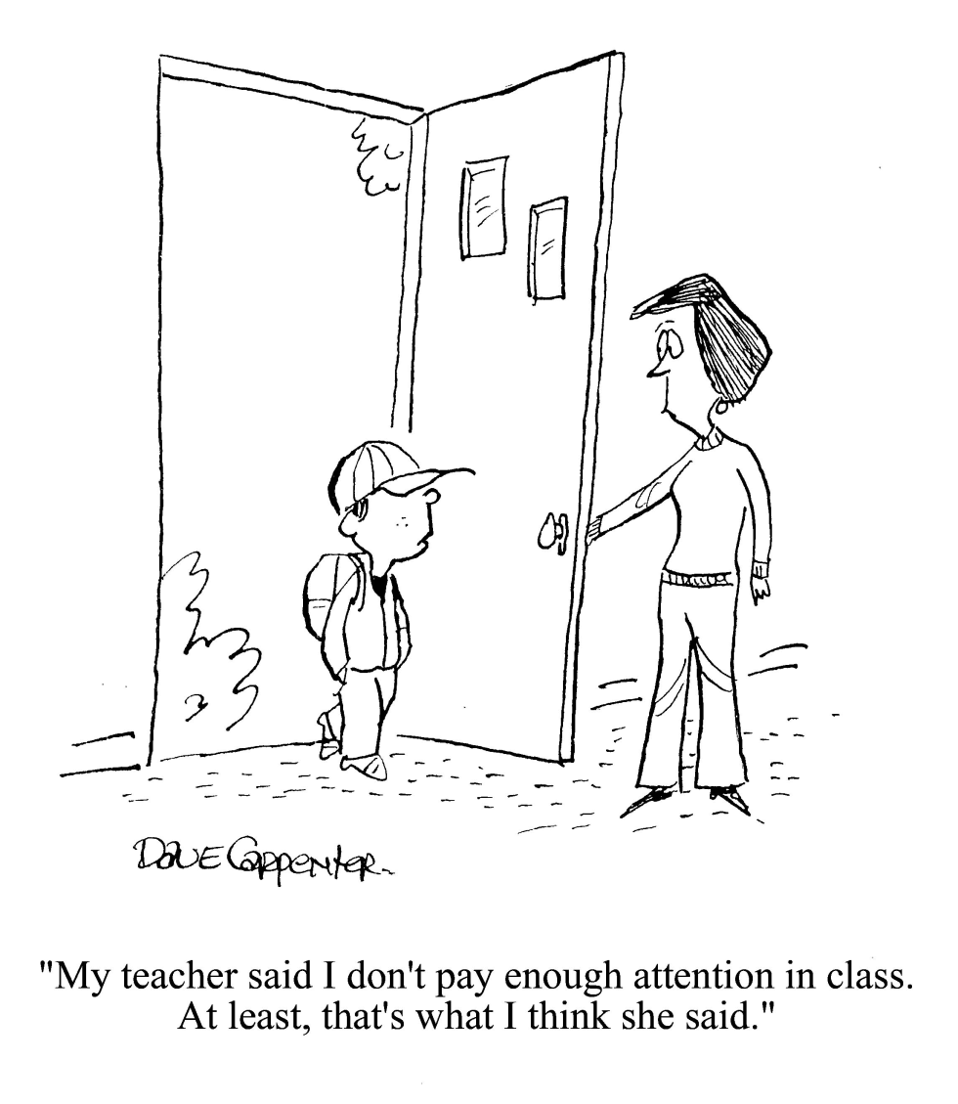
Measures of Progress Monitoring/Treatment Outcome

Slide 72
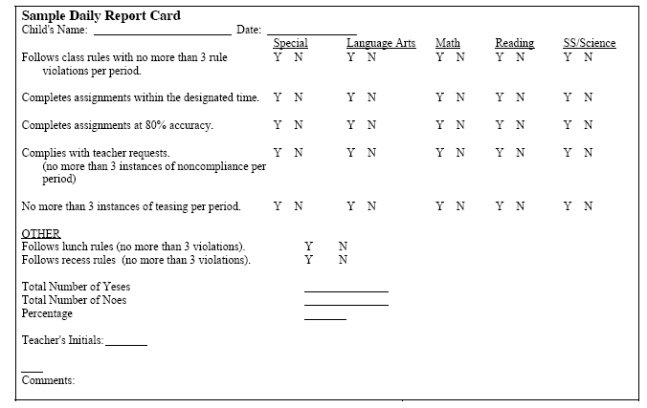
Example of Teacher Progress Monitoring Measure
23/27 = 87%
See http://ccf.fiu.edu; www.jimwrightonline.com; www.directbehaviorratings.com

Slide 73
Enhancing the Effectiveness of Special Education Services for Children with ADHD Using a Daily Report Card Program
Fabiano et al., 2010

Slide 74
Participants

Slide 75
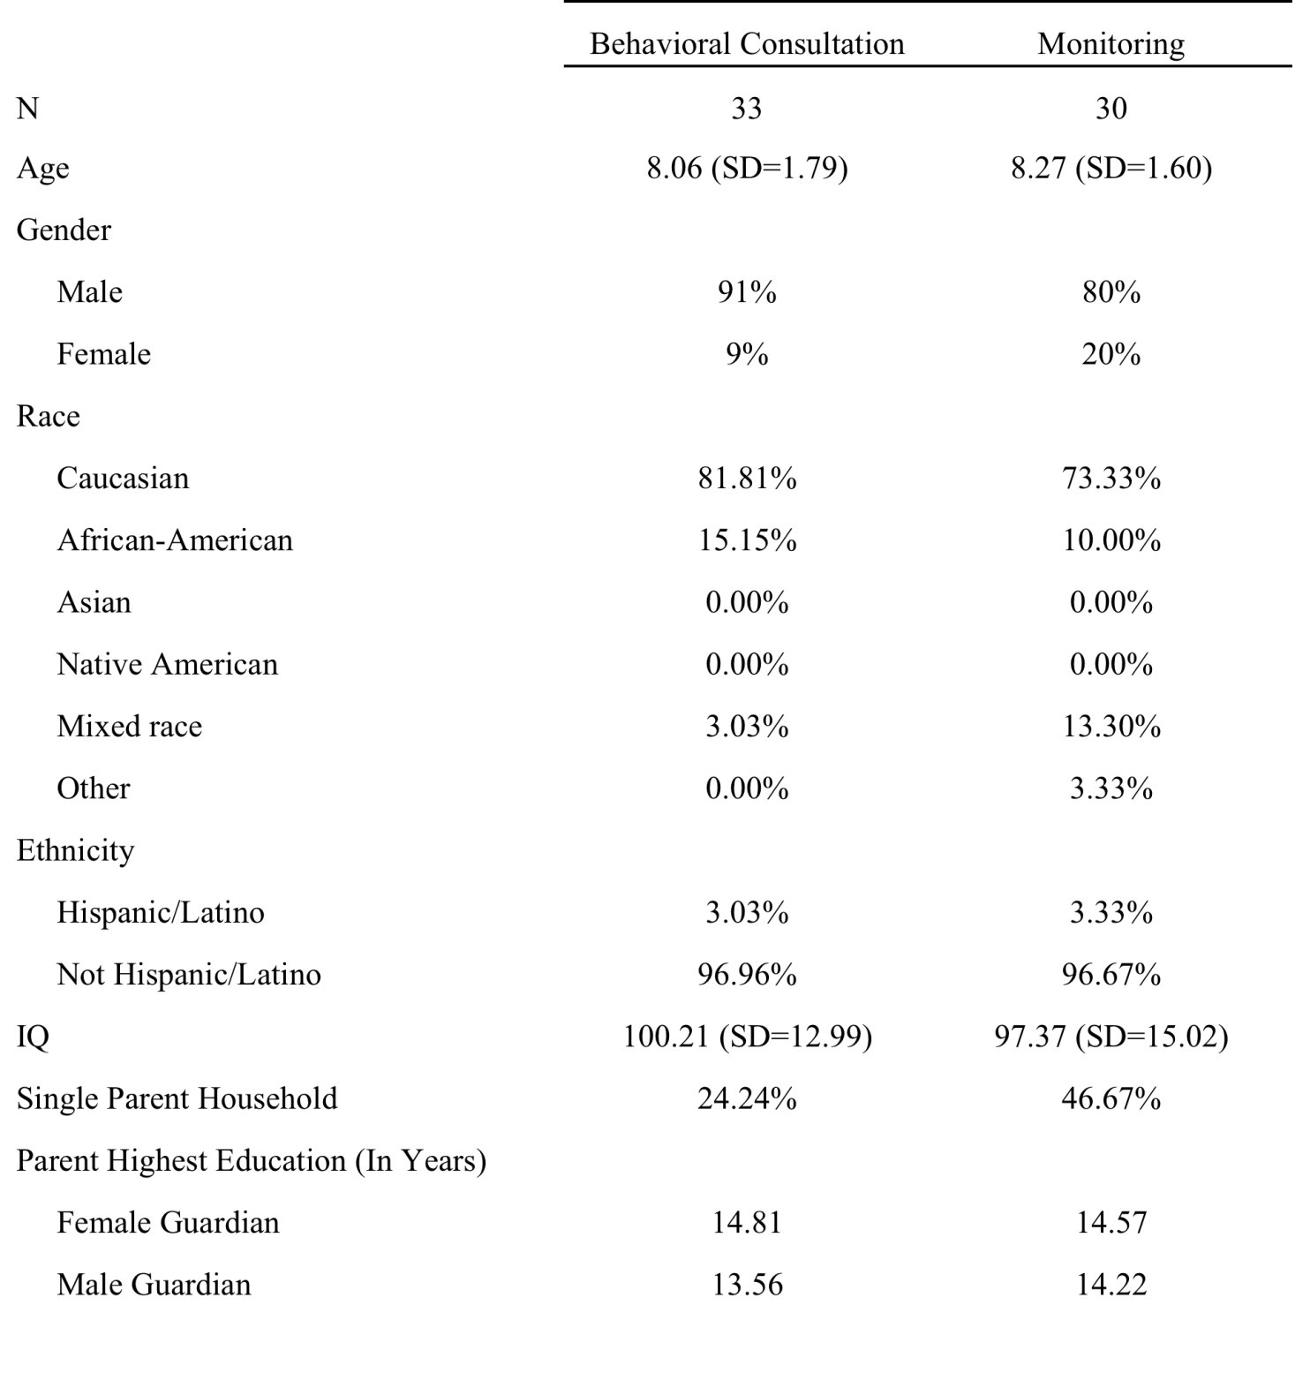

Slide 76
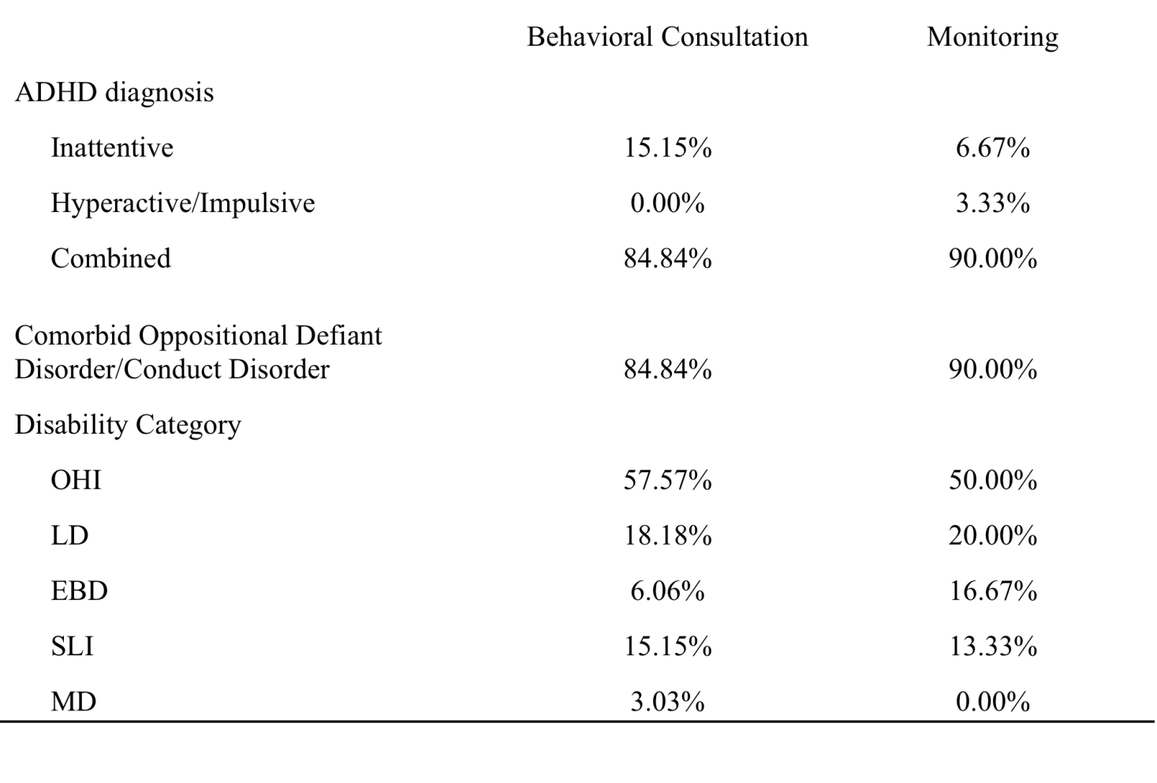

Slide 78
Results

Slide 79
Primary Outcomes Measures
Blinded observations of classroom behavior
Academic Achievement Testing
Teacher Rating of IEP goal attainment

Slide 80
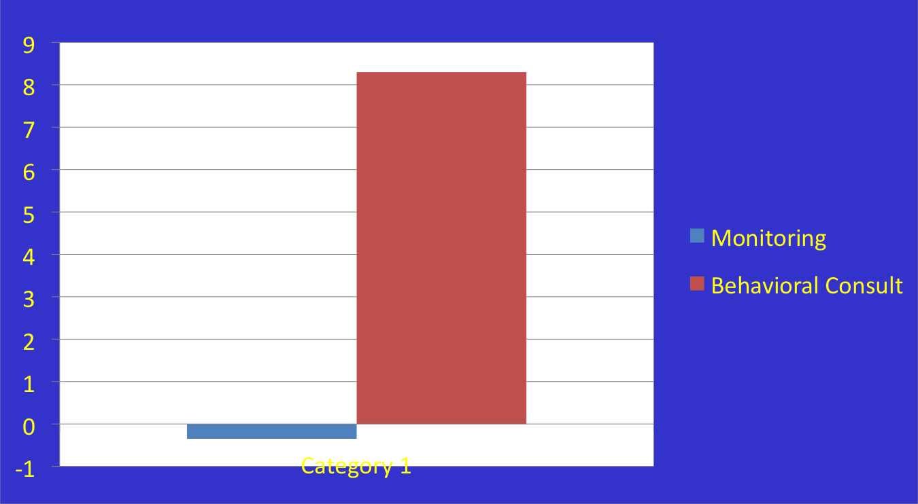
Blinded Observations of Classroom Behavior – Change Score
p < .05

Slide 81
Academic Achievement Testing
Broad Math scores were significantly improved over time (p < .001), whereas Basic Reading scores were not (p > .05).
There was no time x group interaction.

Slide 82
Teacher Ratings of IEP Goal Attainment
Each teacher was asked to rate whether the child had attained idiographic IEP goals and objectives.

Slide 83
For these analyses, there was a significant difference between groups, t (55, one-tailed) = -1.98, p = .027.

Slide 84
Secondary Outcome Measures

Slide 85
ADHD, ODD, CD Symptoms

Slide 86
Impairment Rating Scale

Slide 87
Academic Performance Rating Scale

Slide 88
Teacher Satisfaction

Slide 89
Creating a DRC Intervention

Slide 90
Overview of DRC Components
Select areas for improvement.
Determine how goals will be defined.
Decide on behaviors and criteria for the DRC.
Explain the DRC to the child.
Establish home rewards/privileges.
Monitor and modify the program.
Trouble-shoot.

Slide 91
Comparative and Combined Effects of Behavioral and Pharmacological Treatment

Slide 92
Frequency of Classroom Rule Violations
Fabiano, Pelham, et al., (2007)

Slide 93
Frequency of Classroom Rule Violations
Fabiano, Pelham, et al., (2007)

Slide 94
Frequency of Classroom Rule Violations
Fabiano, Pelham, et al., (2007)

Slide 95
Sequencing of Treatment

Slide 96
Study Design
Pelham, Fabiano, et al., 2016; Page et al., 2016

Slide 97
Treatment Components
Modality | Initial Treatment | Secondary/Adaptive Treatment
Medication | 8-hour stimulant equivalent to 0.15 mg/kg methylphenidate b.i.d. | Increased school dose Added evening/weekend doses
Behavioral Treatment | 8 weekly sessions of group behavioral parent training (concurrent group social skills training for children) Monthly booster parent training sessions 3 consultation meetings with primary teacher to establish a school-home daily report card One individual parent training session to establish home rewards for daily report card | School-based rewards Group or individual classroom contingency management systems Time-out in school Tutoring Organizational skills training Weekly Saturday social skills sessions Homework skills training Paraprofessional-implemented school rewards programs Home-based daily report card

Slide 98
Rules Violations & Disciplinary Events
Pelham, Fabiano, et al., under review

Slide 99
Uptake of Parent Training
Pelham, Fabiano et al., under review

Slide 100
Novel Settings – Developmental Transitions
Interventions should be tailored to important developmental transitions
  e.g., kindergarten entry, learning to drive, work entry
This capitalizes on parent and child/teen motivation to engage in treatment
Target skills and target outcomes are clear
The Relative Age Intervention Supporting Early Learning, Supporting Teens Autonomy Daily (Sibley et al.) as examples.

Slide 101
Kindergarten Entry
Relative Age Effect and ADHD

Slide 102
What is the Relative Age Effect (RAE)?
Individuals born immediately after the cut-off date (i.e., by definition the oldest eligible children) are more likely to be successful in a given context relative to children born immediately before the next cut-off date (i.e., by definition the youngest eligible children).
  Appears repeatedly in sports settings with age cut-offs
  More likely to apply for medical school
  Score higher on cognitive assessments
  Predicts whether one is Chief Executive Officer of Fortune 500 company

Slide 103
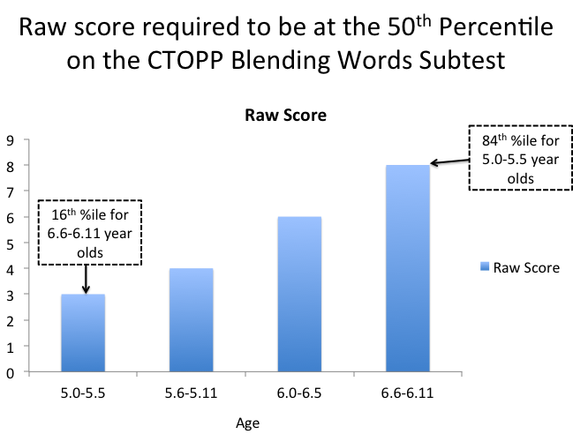
RAE and Kindergarten
Relatively youngest:
  More likely to be retained in kindergarten
  More likely to be placed in special education
  Rated as more problematic by teachers
  More likely to be diagnosed with ADHD
  More likely to be put on medication for school behavior

Slide 104
ADHD and the RAE
Children relatively younger for the grade are at considerably greater risk for ADHD.
  A prevention program that addresses the RAE head on, and provides supports for students who enter relatively younger, may off-set these negative outcomes.
There is a question whether supportive kindergarten intervention will reduce negative outcomes.
There is also a question about the timing of the intervention and the components of the intervention.

Slide 106
Questions?
Resources:
ccf.fiu.edu – Handouts on ADHD, Medication Fact Sheets, Daily Report Card
Understood.org – helpful website for parents, educators, mental health providers
https://sccap53.org/resources/education-resources/effective-child-therapy/
Massive Open Online Course (free): https://www.coursera.org/learn/adhd-treatment
Citation:
Fabiano, G.A. (2023). School Based Interventions for Children and Youth with ADHD [PowerPoint slides]. Webinar sponsored by the Society of Clinical Child and Adolescent Psychology, Division 53 of the American Psychological Association. New York, NY.

